Slide 1
Cs-381 Software Engineering
Course Instructor: Dr. Shazia Arshad
Notes:
Welcome to all of you in this course. I am Dr. Shazia Arshad. I will be your instructor for this course.

Slide 2
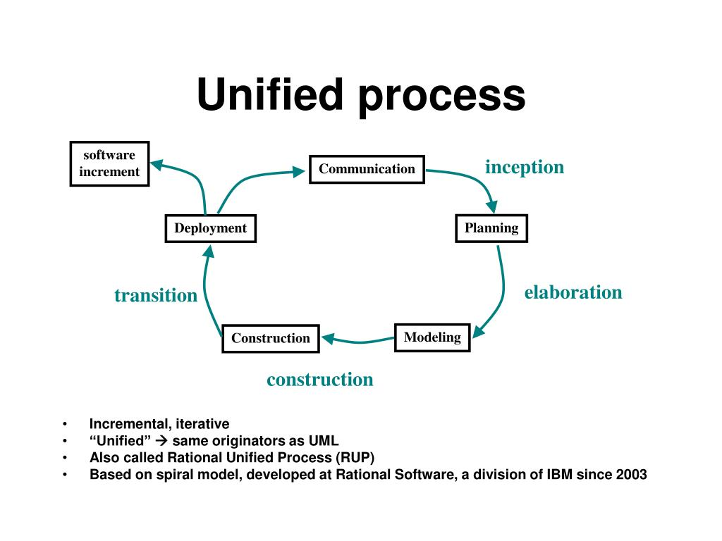
Unified process model
Notes:
Definition:
The Unified Process (UP), or Unified Software Development Process, is an iterative and incremental software development framework from which a customized process can be defined. The framework contains many components and has been modified a number of times to create several variations. The most popular variations include the Rational Unified Process (RUP) and the Open Unified Process (Open UP). The framework has several key characteristics which seem to carry across all variations.
The key characteristics of the Unified Process are:
It is an iterative and incremental development framework
It is architecture-centric with major work being done to define and validate an architectural design for most coding is done
It is risk-focused and emphasizes that highest-risk factors be addressed in the earliest deliverables possible.
It is use-case and UML model driven with nearly all requirements being documented in one of those forms
In general, the Unified Process is built around the idea of incorporating six specific best practices into a configurable process framework. Those best practices are:
Develop Software Iteratively
Manage Requirements
Use Component-based Architectures
Visually Model Software
Verify Software Quality
Control Changes to Software
Use-Case Driven Approach:
A use-case defines the interaction between two or more entities. The list of requirements specified by a customer are converted to functional requirements by a business analyst and generally referred to as use-cases. A use-case describes the operation of a software as interactions between the customer and the system, resulting in a specific output or a measurable return. For example, the online cake shop can be specified in terms of use cases such as 'add cake to cart,' 'change the quantity of added cakes in cart,' 'cake order checkout,' and so on. Each use case represents a significant functionality and could be considered for an iteration.
Architecture-Centric Approach:
Now, let's take a closer look at the architecture-centric approach. Using this approach, you'd be creating a blueprint of the organization of the software system. It would include taking into account the different technologies, programming languages, operating systems, development and release environments, server capabilities, and other such areas for developing the software.
Iterative and Incremental Approach:
And finally, let's take a closer look at the iterative and incremental approach.
Using an iterative and incremental approach means treating each iteration as a mini-project. Therefore, you'd develop the software as a number of small mini-projects, working in cycles. You'd develop small working versions of the software at the end of each cycle. Each iteration would add some functionality to the software according to the requirements specified by the customer.
Now that we saw the distinctive characteristics of the unified process model, let's take a look at the process steps involved.

Slide 3
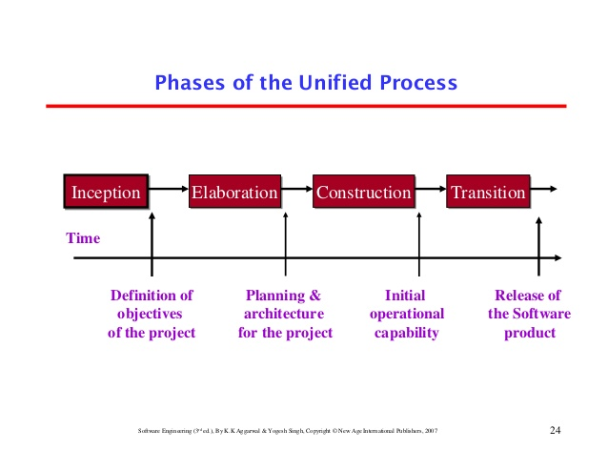
Phases of process model
Notes:
Phases of Unified Process Model:
The life of a software system can be represented as a series of cycles. A cycle ends with the release of a version of the system to customers.
Within the Unified Process, each cycle contains four phases. A phase is simply the span of time between two major milestones, points at which managers make important decisions about whether to proceed with development and, if so, what's required concerning project scope, budget, and schedule.
Inception
Elaboration (milestone)
Construction (release)
Transition (final production release)

Slide 4
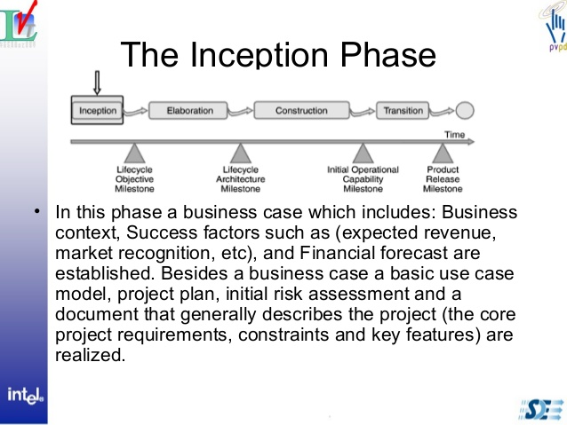
INCEPTION PHASE
Notes:
Inception:
The primary goal of the Inception phase is to establish the case for the viability of the proposed system.
The tasks that a project team performs during Inception include the following:
Defining the scope of the system (that is, what's in and what's out)
Outlining a candidate architecture, which is made up of initial versions of six different models
Identifying critical risks and determining when and how the project will address them
Starting to make the business case that the project is worth doing, based on initial estimates of cost, effort, schedule, and product quality
The major milestone associated with the Inception phase is called Life-Cycle Objectives. The indications that the project has reached this milestone include the following:
The major stakeholders agree on the scope of the proposed system.
The candidate architecture clearly addresses a set of critical high-level requirements.
The business case for the project is strong enough to justify a green light for continued development.

Slide 5
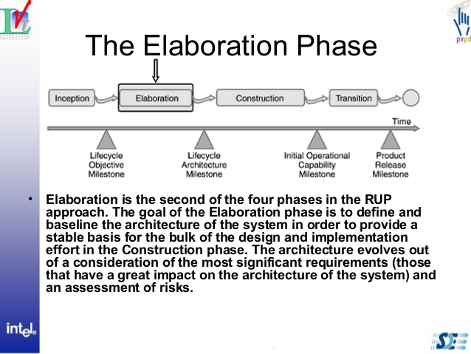
Elaboration Phase
Notes:
Elaboration Phase:
The primary goal of the Elaboration phase is to establish the ability to build the new system given the financial constraints, schedule constraints, and other kinds of constraints that the development project faces.
The tasks that a project team performs during Elaboration include the following:
Capturing a majority of the remaining functional requirements.
Expanding the candidate architecture into a full architectural baseline, which is an internal release of the system focused on describing the architecture.
Addressing significant risks on an ongoing basis
Finalizing the business case for the project and preparing a project plan that contains sufficient detail to guide the next phase of the project (Construction)
The architectural baseline contains expanded versions of the six models initialized during the Inception phase.
The major milestone associated with the Elaboration phase is called Life-Cycle Architecture. The indications that the project has reached this milestone include the following:
Most of the functional requirements for the new system have been captured in the use case model.
The architectural baseline is a small, that will serve as a solid foundation for ongoing development.
The business case has received a green light, and the project team has an initial project plan that describes how the Construction phase will proceed.

Slide 6

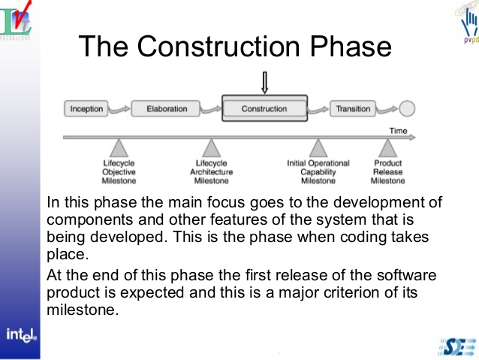
Construc--tion phase
Notes:
The Construction Phase is the part of the framework where software development, integration, and testing takes place. Because of the emphasis on component-based architectures and the significant attention paid to the architectural plan in the Inception and Elaboration phases, it should be possible to initiate multiple Construction Phases within a single cycle if the software to be developed is complex enough to support multiple discrete components.
The specific activities of this phase include:
The software is built, integrated, and tested.
The user manuals have been created (or updated).
The details of the software developed are documented and ready to be provided to end users or support staff (including changes, etc.)
The milestones (that together comprise the Initial Operational Capability Milestone) that show completion of the Construction phase are:
The software product is stable and mature enough to be deployed to end users.
All stakeholders are ready to transition to the new / updated software.
Actual versus planned expenditures are still acceptable enough to move forward with the project.
The outcome of the construction phase should be a product that is ready to put into the hands of end-users in at least a beta release state.

Slide 7
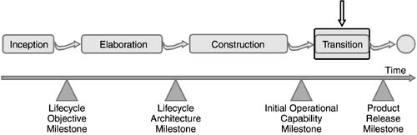
TRANSITION PHASE
Notes:
Transition phase:
The Transition Phase of the framework is where the software is deployed to end users and is essentially a broad beta test of the application. Users begin to use the new software, issues are identified and potentially corrected, and any features that were delayed are finished and deployed. The transition phase can include multiple iterations of the software, including beta releases, bug fixes, and enhancements.
The specific activities of this phase include:
Beta testing or user acceptance testing by end users to validate the new software against user expectations.
Parallel operation with legacy systems (if in existence) that will be replaced.
Operational databases are converted (if necessary).
Users and maintainers of the software are fully trained.
The software is fully rolled-out
The milestones (that together comprise the Product Release Milestone) that show completion of the Transition phase are:
Users are satisfied with the software.
Actual versus planned expenditures are still acceptable enough to move forward with the project.

Slide 8

COMPONANTS OF UPM
Notes:
The Components of the Unified Process:
The Unified Process framework is made up of the following components:
Cycles
Phases
Iterations
Disciplines (also known as Workflows)
Activities
Artifacts
Workers

Slide 9
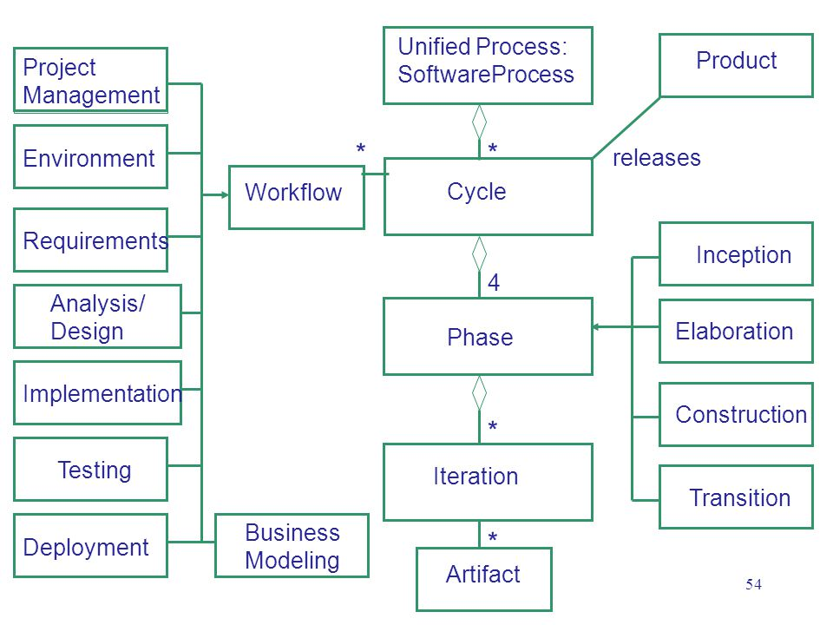
WORKFLOW OF UNIFIED PROCESS MODEL:
Notes:
The Five Workflows:
Within the Unified Process, five workflows cut across the set of four phases: Requirements, Analysis, Design, Implementation, and Test. Each workflow is a set of activities that various project workers perform.
The following subsections provide brief overviews of these workflows.
Requirements:
The primary activities of the Requirements workflow are aimed at building the use case model, which captures the functional requirements of the system being defined. This model helps the project stakeholders reach agreement on the capabilities of the system and the conditions to which it must conform.
The use case model also serves as the foundation for all other development work.
Analysis:
The primary activities of the Analysis workflow are aimed at building the analysis model, which helps the developers refine and structure the functional requirements captured within the use case model. This model contains realizations of use cases that lend themselves to design and implementation work better than the use cases.
Design:
The primary activities of the Design workflow are aimed at building the design model, which describes the physical realizations of the use cases from the use case model, and also the contents of the analysis model.
The Design workflow also focuses on the deployment model, which defines the physical organization of the system in terms of computational nodes.

Slide 10
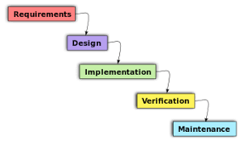
WORKFLOW OF UNIFIED PROCESS MODEL:
Continue
Notes:
The Five Workflows:
The remaining workflows are these:
Implementation:
The primary activities of the Implementation workflow are aimed at building the implementation model, which describes how the elements of the design model are packaged into software components, such as source code files, dynamic link libraries (DLLs).
Test:
The primary activities of the Test workflow are aimed at building the test model, which describes how integration and system tests will exercise executable components from the implementation model. The test model also describes how the team will perform those tests as well as unit tests.
The test model contains test cases that are often derived directly from use cases. Testers perform black-box testing using the original use case text, and white-box testing of the realizations of those use cases, as specified within the analysis model. The test model also contains the results of all levels of testing.

Slide 11
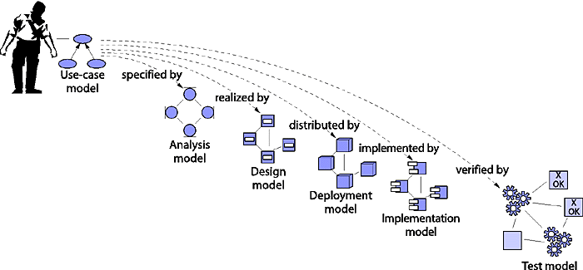
EXAMPLE
Notes:
Example of Unified process model:
Let's say you own a small baking company, where you make and design custom cakes for different occasions. You now wish to take your business online, so that you could cater to a large customer base. You hire a web development company to build an online cake store for you. What kind of an approach would you like the developers to have towards creating your website? Would you want to receive the completed website all at once after a month, or would you like it to be developed in stages, so that you could take a look at the working software and request any modifications right away? It would be reasonable to go with the second approach, as you'd get to see well-developed bits of your website. It would also ensure that the developers were proceeding in the right direction. This is the same approach that you'd take if you were building a software product on the basis of the unified process model.

Slide 12


PROS AND CONS
Notes:
Advantages of Unified process model:
Allows for the adaptive capability to deal with changing requirements throughout the development life cycle, whether they be from customers or from within the project itself.
Emphasizes the need (and proper implementation of) accurate documentation.
Diffuses potential integration headaches by forcing integration to occur throughout development, specifically within the construction phase where all other coding and development is taking place.
Disadvantages of Rational Unified Process:
Heavily relies on proficient and expert team members, since assignment of activities to individual workers should produce tangible, pre-planned results in the form of artifacts.
Given the emphasis on integration throughout the development process, this can also be detrimental during testing or other phases, where integrations are conflicting and getting in the way of other, more fundamental activities.
Arguably, Rup is a fairly complicated model. Given the assortment of the components involved, including best practices, phases, building blocks, milestone criteria, iterations, and workflows, often proper implementation and use of the Rational Unified Process can be challenging for many organizations, particularly for smaller teams or projects.

Slide 13

ANY QUERY
Notes:
Discuss the difference between agile and unified process?

